Slide 1

Smart AI-Powered Customer Support Chatbot
Submitted to:
Mr. Gyan Chandra Vishwakarma
Asst. Professor
Presented by:
Basharat Hassan, 2022521926
DEPARTMENT OF COMPUTER SCIENCE & ENGINEERING,
SHARDA UNIVERISTY, GREATER NOIDA, UTTAR PARDESH

Slide 2
Problem Statement
Small businesses struggle to offer 24/7 customer support
Hiring human agents is expensive
Customers expect instant responses
FAQs exist, but not always easy to find or use
Problem: No scalable, automated way for small businesses to respond to common customer queries instantly

Slide 3
Project Idea / Solution
Idea: Create a GenAI-powered chatbot trained on company FAQs/help docs
Responds instantly to customer queries
Can be deployed on websites
Uses either:
Retrieval-Augmented Generation (RAG) for dynamic answers or
Fine-tuned GPT model or

Slide 4
Why GenAI?
Understands natural language
Generates human-like, contextual replies
Can be trained or enhanced using custom company knowledge
More scalable and flexible than rule-based bots
Ideal for unstructured data like help docs or FAQs

Slide 5
Use Case & Users
Use Case: 24/7 automated customer support
Users:
Small business owners
Customers visiting websites or messaging on WhatsApp
Industries: E-commerce, SaaS, EdTech, Travel, Local Services

Slide 6
Tech Stack
AI & Language Models
OpenAI GPT-3.5 / GPT-4 – for generating responses / Mistral / LLaMA2 – open-source alternatives
Embedding Model – text-embedding-ada-002 / SentenceTransformers
Retrieval & Vector Store (RAG)
Vector Database – FAISS / Chroma / Pinecone
RAG Framework – LangChain / LlamaIndex
Backend
Language – Python, Frameworks – FastAPI / Flask, Libraries – LangChain, OpenAI API, PyMuPDF (for PDF parsing)
Frontend (Chat Interface)
React.js – for modern web UI or Streamlit – for a quick prototype
Data & Storage
Source Data – FAQs, Help Docs, PDFs, Website text, Company FAQs, Help docs (PDFs, website content)
Optional DB – PostgreSQL / SQLite for logs, user queries
Deployment
Frontend – Vercel / Render
Backend – Railway / Hugging Face Spaces / AWS / GCP

Slide 7
Project Architecture
Goal: Enable the chatbot to automatically answer customer queries using the company’s FAQs and help docs, using Retrieval-Augmented Generation (RAG) or Fine-tuned LLM.
Architecture (RAG-based Flow)
[1] User Query
↓
[2] Chat Interface (Web)
↓
[3] Query Preprocessor
↓
[4] Retriever (Search Knowledge Base)
↓
[5] Generator (LLM creates answer)
↓
[6] Response to User

Slide 8
Step-by-Step Components
1. Chat Interface
Frontend where users interact with the bot.
It is an a web based chat widget (built with Streamlit, React, Flask).
2. Query Preprocessor
Prepares the user input (e.g., remove special characters, lowercasing)
Optional: Add spell correction, language detection
3. Retriever (RAG Part 1)
Searches a knowledge base of documents
Documents (FAQs, help docs) are chunked and embedded using models like text-embedding-ada-002
Stored in a Vector Database (like FAISS, Chroma, Pinecone)
Retrieves the top-k most relevant chunks based on similarity
4. Generator (RAG Part 2)
Sends the user query + retrieved context to an LLM (like GPT-4, Mistral, or LLaMA2)
LLM uses both to generate a human-like, accurate, context-rich response
This is what makes it “retrieval-augmented” generation
5. Response to User
The final AI-generated response is sent back to the user in the chat interface
Can be followed by a feedback button: “Was this helpful?”

Slide 9
Step-by-Step Components
Optional (Advanced)
Logging system: Logs all user questions and AI answers for review
Fallback handler: “Sorry, I don’t have info on that. Would you like to talk to a human?”
Multilingual support: Translate queries and answers
What If You Use Fine-Tuning Instead of RAG?
You take a base GPT model and fine-tune it on all your FAQ pairs
Easier for fixed questions, but RAG is better when:
The content updates often
You have large documents
You want transparency (show the source)

Slide 10
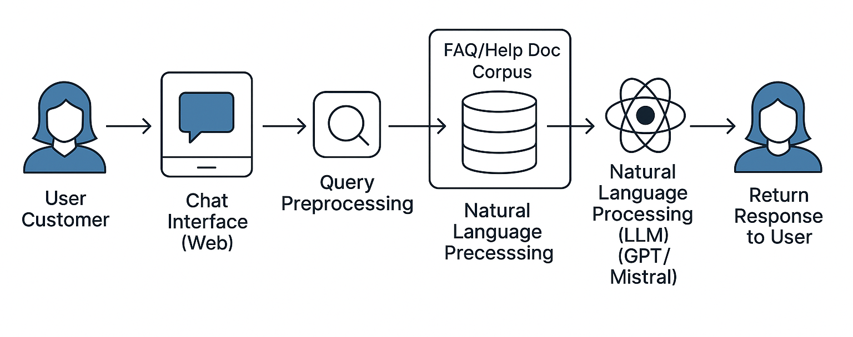
Architecture Diagram

Slide 11
Sample Dataset / Demo Flow
Example FAQ:
Q: "How do I return a product?"
A: "To return a product, go to your Orders > Return > Select reason..."
Screenshot (if available) of sample chatbot answering a user query
Alternatively: Show flow from user question → retrieved doc → generated answer

Slide 12
Benefits & Future Scope
Benefits:
24/7 automated support
Scales with business growth
Reduces customer wait times
Lower support costs
Future Scope:
Multilingual support
Voice-enabled bot
Sentiment detection
Analytics dashboard (FAQs most asked, bot accuracy)

Slide 13
Conclusion
Smart, scalable solution to a real-world problem
Empowers small businesses with AI
Demonstrates practical use of GenAI + RAG
Future-proof customer support solution

Slide 14
Thank You

